Slide 1
PROJECT TITLE SECURE DATA HIDING IN IMAGE USING STEGANOGRAPHY
SECURE THE DATA TO PREVENT HACKERS
Presented By: Yashasree gudhneya
Student Name : yashasree gudhneya
College Name & Department : ICFAI , BTECH

Slide 2
OUTLINE
Problem Statement
Technology used
Wow factor
End users
Result
Conclusion
Git-hub Link
Future scope

Slide 3
Problem Statement
With the increasing need for secure communication, traditional encryption methods alone are not always sufficient to protect sensitive data from unauthorized access.
Steganography provides an additional layer of security by concealing information within digital images, making it nearly undetectable.
However, existing techniques may suffer from low capacity, poor image quality, or vulnerability to attacks.
This project aims to develop an efficient and secure image steganography method that ensures high data concealment while maintaining image integrity and resistance to detection.

Slide 4
Technology used
Libraries:
OpenCV
OS
String
Platforms:
IDLE
Python 3.12
Windows

Slide 5
Wow factors
Advanced Security – It goes beyond simple LSB techniques by integrating encryption (like AES/RSA) before embedding data, ensuring double-layered protection.
Adaptive Encoding – The algorithm dynamically selects image regions for embedding based on complexity, minimizing visual distortions.
Efficient Storage – It optimizes data embedding capacity while maintaining image quality, making detection difficult.
Cross-Platform Compatibility – Works on various OS platforms (Windows, Linux) using Python libraries like OpenCV, NumPy, and PIL for seamless processing.
User-Friendly Interface – Can be extended to a GUI-based application for easy use without requiring deep technical knowledge.

Slide 6
End users
Cybersecurity Professionals – For securely transmitting sensitive data without raising suspicion.
Journalists & Activists – To secretly communicate in regions with strict censorship.
Government & Military – For covert communication and secure intelligence sharing.
Corporate Users – To protect confidential business data from cyber threats.
Individuals & Privacy Enthusiasts – For personal secure messaging and data protection.

Slide 7
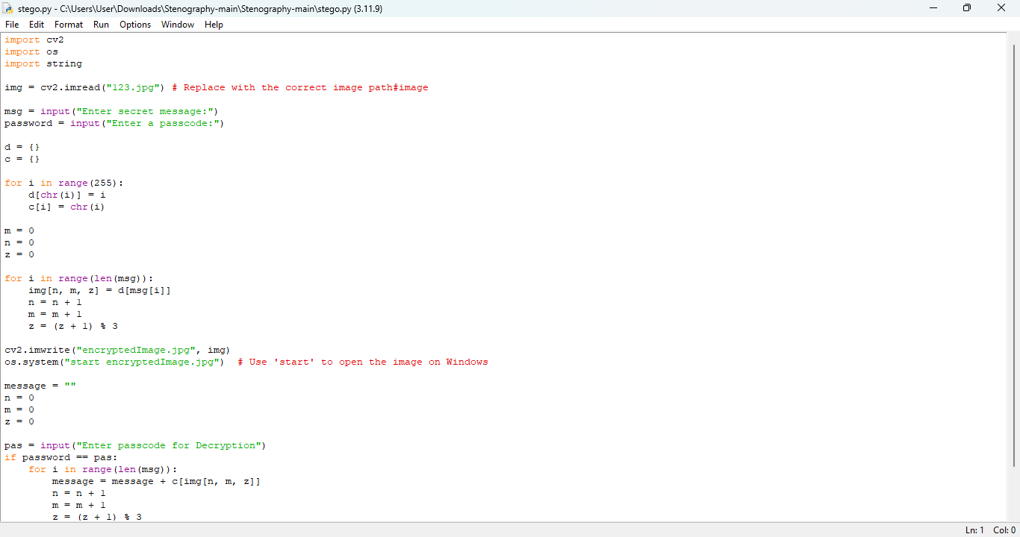
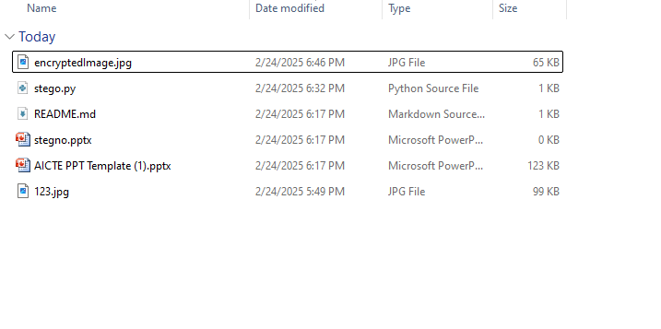
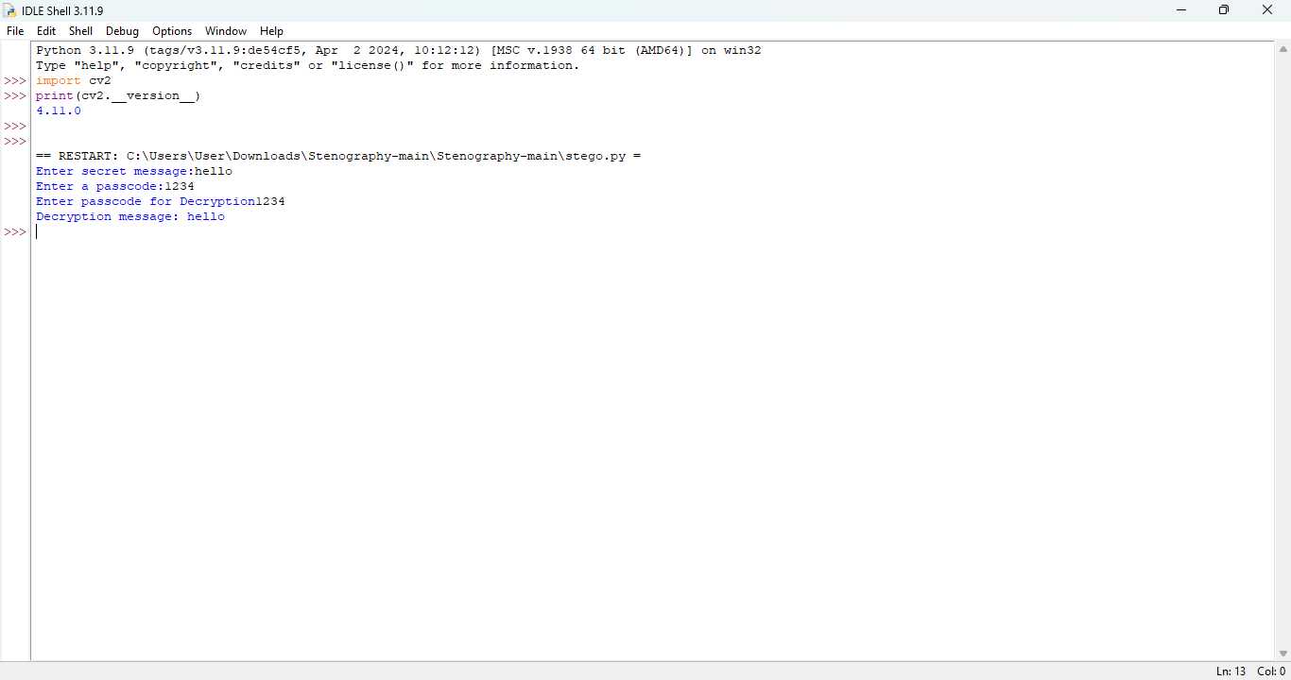
Results

Slide 8
Conclusion
My project Secure Data Hiding in Image Using Steganography, successfully addresses the challenge of securely transmitting sensitive information by embedding data within images. By leveraging steganography techniques, we ensure that confidential data remains undetectable to unauthorized users while maintaining the original image's integrity. The implementation using Python and OpenCV provides an efficient and user-friendly solution for secure communication. This project can be widely used in cybersecurity, corporate security, journalism, and personal privacy, making it a reliable and practical approach to covert data transmission.

Slide 9
GitHub Link
https://github.com/yashasreeg1/steganography.git

Slide 10
Future scope
This project can be enhanced by integrating AI-based steganalysis resistance to prevent detection by advanced security tools. Future improvements may include dynamic encoding techniques that adapt based on image complexity, increasing security while maintaining image quality. Additionally, implementing multi-layer encryption (AES/RSA) before embedding data will further enhance confidentiality. The project can also be extended to support video and audio steganography, making it a versatile tool for secure communication. Lastly, a GUI-based application or mobile app can be developed for easy and widespread usage.

Slide 11
THANK YOU

